Slide 1


Tech ABC Corp - HR Database
Jahid Razan 31 Dec, 2022

Slide 2
Business Scenario
Business requirement
Tech ABC Corp saw explosive growth with a sudden appearance onto the gaming scene with their new AI-powered video game console. As a result, they have gone from a small 10 person operation to 200 employees and 5 locations in under a year. HR is having trouble keeping up with the growth, since they are still maintaining employee information in a spreadsheet. While that worked for ten employees, it has becoming increasingly cumbersome to manage as the company expands.
As such, the HR department has tasked you, as the new data architect, to design and build a database capable of managing their employee information.
Dataset
The HR dataset you will be working with is an Excel workbook which consists of 206 records, with eleven columns. The data is in human readable format, and has not been normalized at all. The data lists the names of employees at Tech ABC Corp as well as information such as job title, department, manager's name, hire date, start date, end date, work location, and salary.
IT Department Best Practices
The IT Department has certain Best Practices policies for databases you should follow, as detailed in the Best Practices document.

Slide 3
Step 1
Data Architecture Foundations

Slide 4
Step 1: Data Architecture Foundations
Hi,
Welcome to Tech ABC Corp. We are excited to have some new talent onboard. As you may already know, Tech ABC Corp has recently experienced a lot of growth. Our AI powered video game console WOPR has been hugely successful and as a result, our company has grown from 10 employees to 200 in only 6 months (and we are projecting a 20% growth a year for the next 5 years). We have also grown from our Dallas, Texas office, to 4 other locations nationwide: New York City, NY, San Francisco, CA, Minneapolis, MN, and Nashville, TN.
While this growth is great, it is really starting to put a strain on our record keeping in HR. We currently maintain all employee information on a shared spreadsheet. When HR consisted of only myself, managing everyone on an Excel spreadsheet was simple, but now that it is a shared document I am having serious reservations about data integrity and data security. If the wrong person got their hands on the HR file, they would see the salaries of every employee in the company, all the way up to the president.
After speaking with Jacob Lauber, the manager of IT, he suggested I put in a request to have my HR Excel file converted into a database. He suggested I reach out to you as I am told you have experience in designing and building databases. When you are building this, please keep in mind that I want any employee with a domain login to be have read only access the database. I just don't want them having access to salary information. That needs to be restricted to HR and management level employees only. Management and HR employees should also be the only ones with write access. By our current estimates, 90% of users will be read only.
I also want to make sure you know that am looking to turn my spreadsheet into a live database, one I can input and edit information into. I am not really concerned with reporting capabilities at the moment. Since we are working with employee data we are required by federal regulations to maintain this data for at least 7 years; additionally, since this is considered business critical data, we need to make sure it gets backed up properly.
As a final consideration. We would like to be able to connect with the payroll department's system in the future. They maintain employee attendance and paid time off information. It would be nice if the two systems could interface in the future.
I am looking forward to working with you and seeing what kind of database you design for us.
Thanks,
Sarah Collins
Head of HR

Slide 5
Data Architect Business Requirement
Request from the business partner : Create a database with the employee information for the HR department.
Current data management solution: Currently, the HR maintains all employee information on a shared spreadsheet
Currently available data : Currently the excel file contains 15 columns and 205 rows. It has personal information of the employees such as-
Personal: Name, address, location, city, state, educational level
Employment related information: Id of the employee, job title, Date of hire, starting and ending dates of a specific role, job title(s), manager of the employee, department, work email.
Additional data requests: No
Ownership /management of data: HR department will own/manage the data.
Who will have access to database
Users with domain access: read only access to tables, and no access to salary information
HR and Management: read and write access, also have access to salary information.

Slide 6
Data Architect Business Requirement
Estimated size of database: Currently the excel data has 15 columns and 205 rows of employee information.
Estimated annual growth: The information is expected to have a 20% growth per year for the next 5 years
Sensitive/restricted data:
For all users with domain login (covers approxitmately) 90% of the users should have NO access to Salary information.
Only management and HR employees should have access to salary information.

Slide 7
Data Architect Technical Requirement
Justification for the new database
Data Integrity and Security: Currently, the shared excel document can easily cause data integrity and data security issue. Also, it can potentially lead to compromise of sensitive information like employee salary.
Federal regulation and criticality: As per federal regulations the company has an obligation to store HR data for at least 7 years. Also, additionally, since this is considered business critical data, it requires secured back up which required a new database.
Possible Interface with other departments: Preserving the data in a database would provide the option to interface the information with the payroll department's system in the future which can be done in a more secured way using database.
Growth of information: With the expected growth of information in the coming years for the company, an excel file is more error prone and hard to achieve restriction control.
Database objects
For the database Following objects will be created:
Tables: Jobs, department, education, manager, employee, job history, salary, city_address, location
Views: A view containing all the current information will be created so that it can be ensured that the existing data can be regenerated using the normalized tables.
Data ingestion
Since the current HR database is in a flatfile format, ETL is the current best practice for working with flat files.

Slide 8
Data Architect Technical Requirement
Data governance (Ownership and User access)
HR department will own and maintain the data
User Access:
1. Users will not be granted access to the database.
2. Users will be granted access to all tables in the database, then access will be revoked to any tables holding restricted data (i.e. salary information in this case).
3. Only HR and management level employees will have the write access.
Scalability & Flexibility
The HR department would like to be able to connect with the payroll department's system in the future. This would be a read-only access.
Although there is an expected employee growth of 20% for the next 5 years, only 10% of the estimated users requires the write access. This is not a database where gigabytes of new data will be inserted on a daily basis. For the Increased reading demand in the future, database replication would be sufficient.
Storage & retention
Storage (disk or in-memory): Since the data does not need higher level computation, the data will be stored in spinning disk. With current 205 rows of data and estimated increase of 20% per year, there is no immidate need for a large partition since the data will be well within 10 k rows.
Federal regulations requires maintaining this data for at least 7 years;
Backup
Since this is considered critical business data, there will be full backup 1x per week, incremental backup daily.

Slide 9
Step 2
Relational Database Design

Slide 10
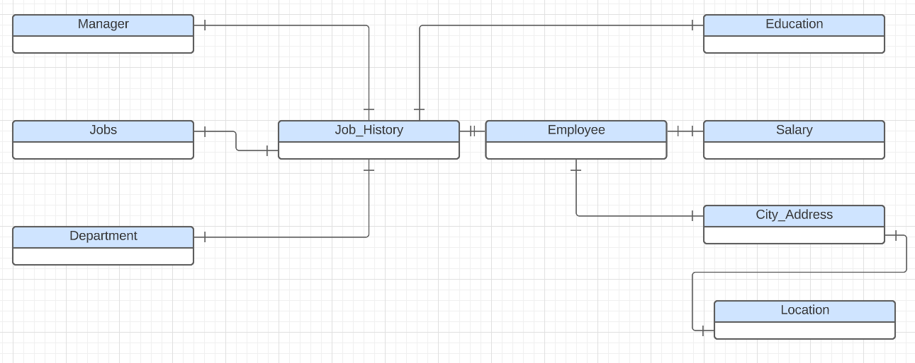
CONCEPTUAL ERD

Slide 11
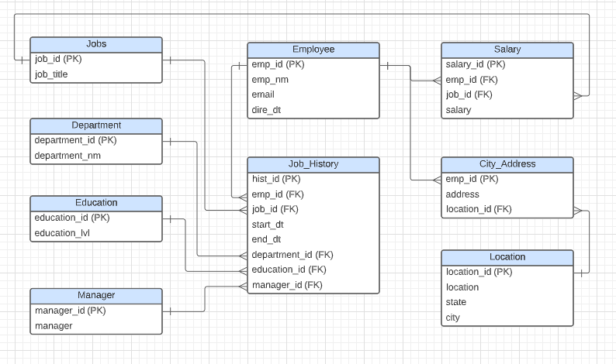
LOGICAL ERD

Slide 12
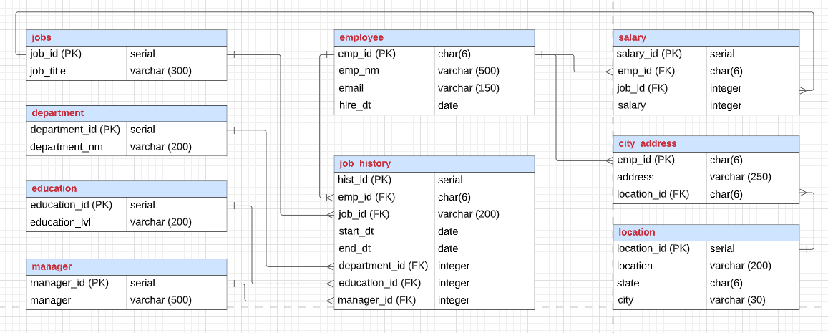
PHYSICAL ERD

Slide 13
Step 3
Create A Physical Database

Slide 14
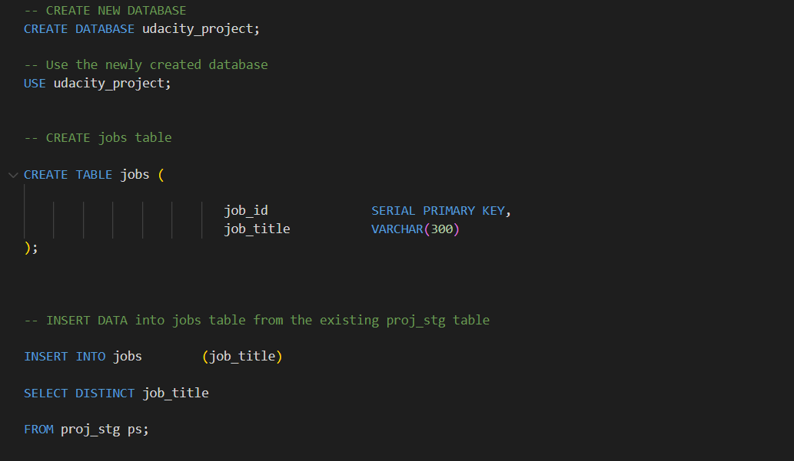
DDL JOBS TABLE

Slide 15
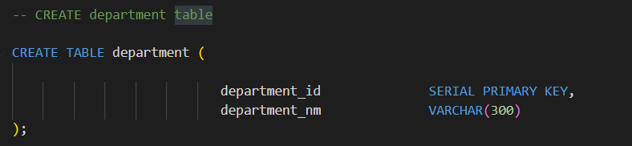
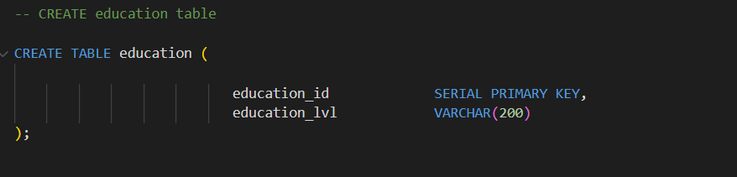
DDL DEPARTMENT & EDUCATION TABLE

Slide 16
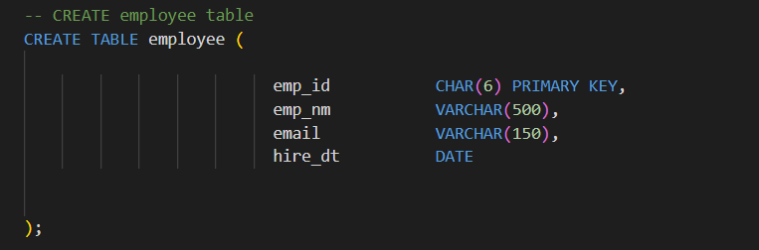
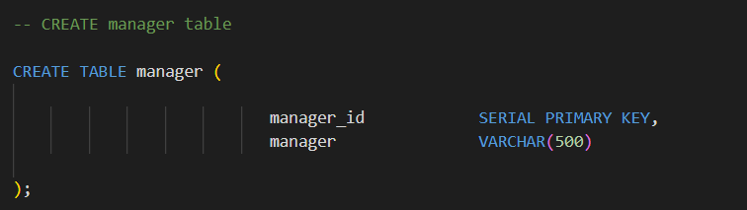
DDL EMPLOYEE & MANAGER TABLE

Slide 17
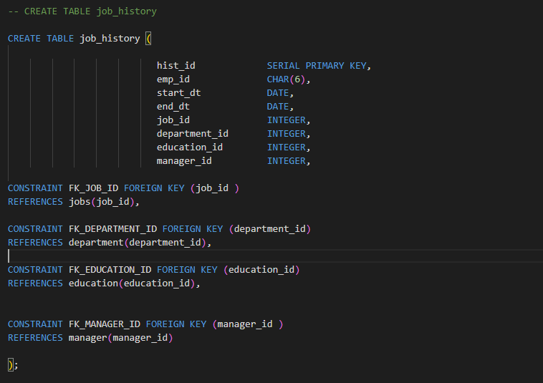
DDL JOB_HISTORY TABLE

Slide 18
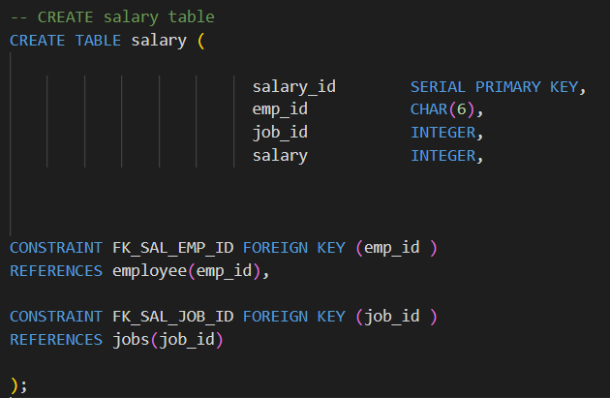
DDL SALARY TABLE

Slide 19
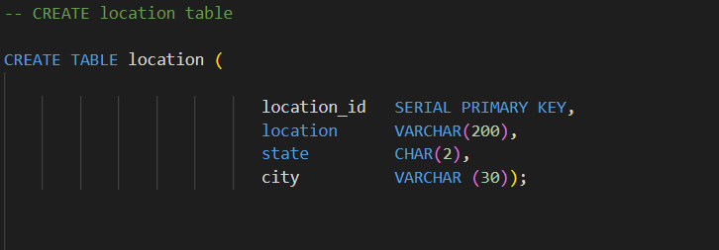
DDL LOCATION TABLE

Slide 20
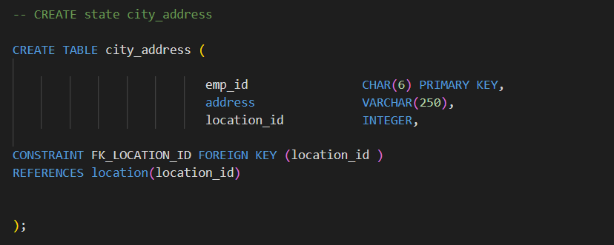
DDL CITY_ADDRESS TABLE

Slide 21
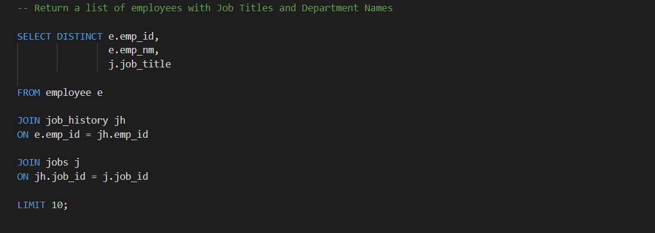
CRUD
Question 1: Return a list of employees with Job Titles and Department Names

Slide 22
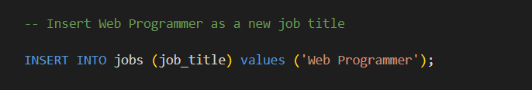
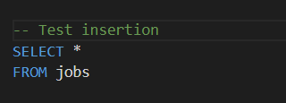
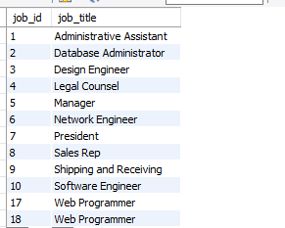
CRUD
Question 2: Insert Web Programmer as a new job title

Slide 23
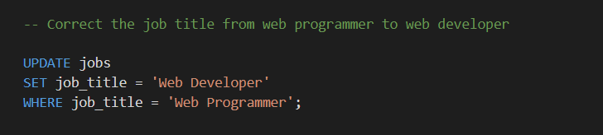
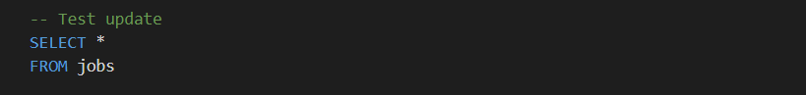
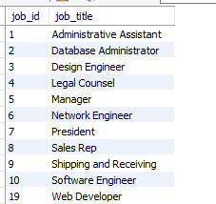
CRUD
Question 3: Correct the job title from web programmer to web developer

Slide 24
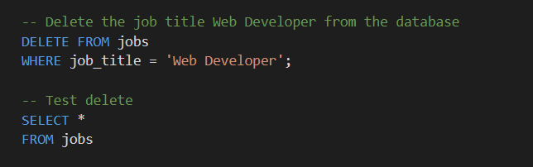
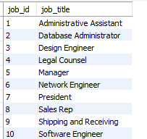
CRUD
Question 4: Delete the job title Web Developer from the database

Slide 25
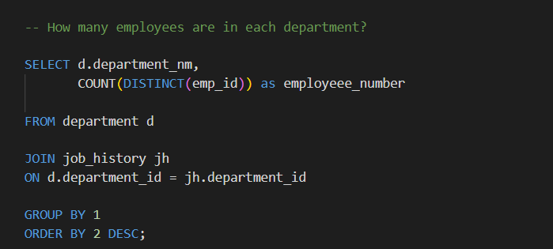
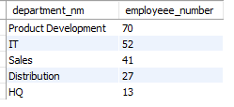
CRUD
Question 5: How many employees are in each department?

Slide 26
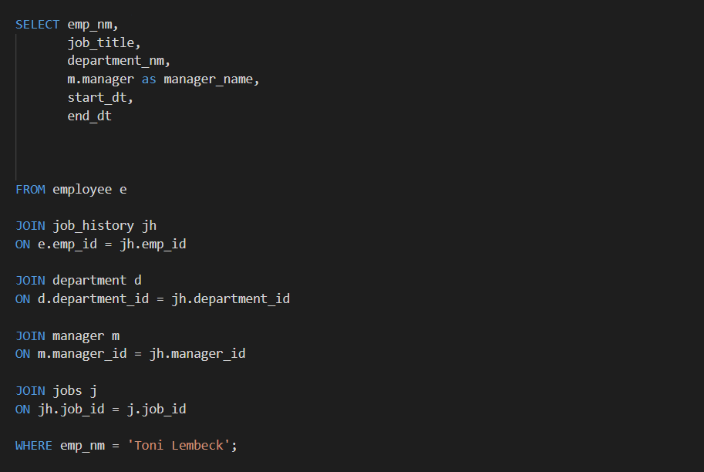
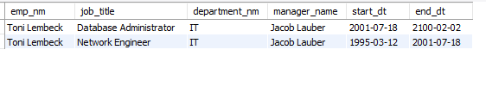
CRUD
Question 6: Write a query that returns current and past jobs (include employee name, job title, department, manager name, start and end date for position) for employee Toni Lembeck.

Slide 27
CRUD
Question 7: Describe how you would apply table security to restrict access to employee salaries using an SQL server.
Permission will be granted to users access to all tables in the database.
Then access will be revoked to salary tables for an employee unless he is from HR department and management who should have access to the file.

Slide 28
Step 4
Above and Beyond (optional)

Slide 29
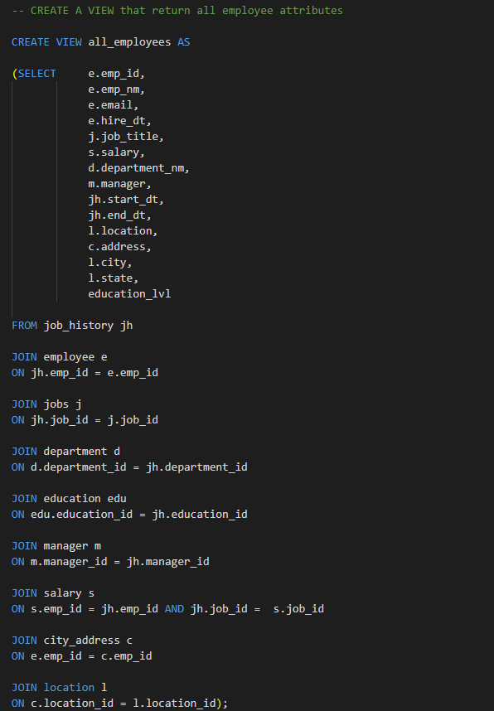
Create a view that returns all employee attributes; results should resemble initial Excel file

Slide 30
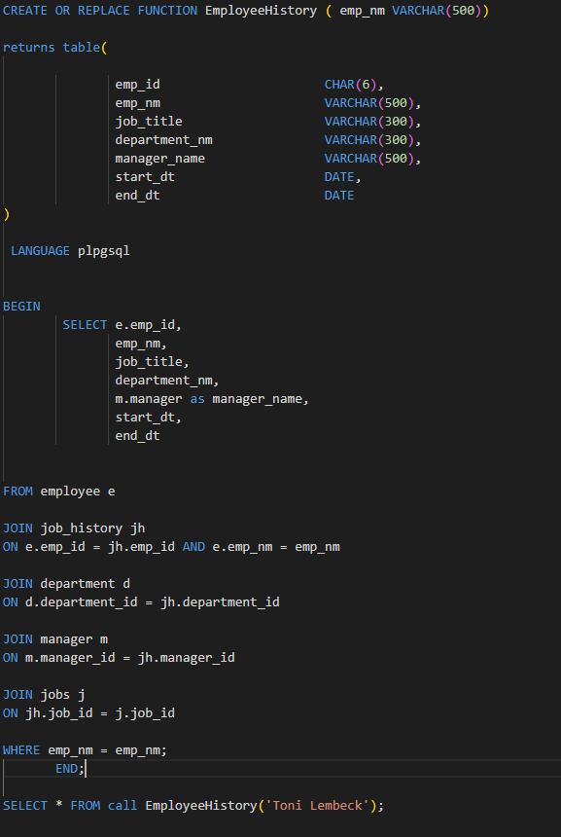
Create a stored procedure with parameters that returns current and past jobs (include employee name, job title, department, manager name, start and end date for position) when given an employee name.

Slide 31
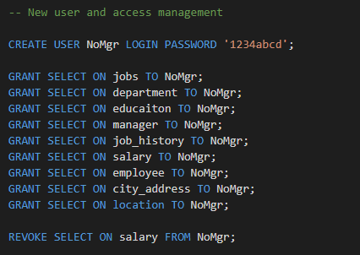
Create a non-management user named NoMgr. Show the code of how your would grant access to the database, but revoke access to the salary data.Submit screenshot of code

